Slide 1
Challenges and Opportunities before Youth in Agriculture

Slide 2
The Context
From Bengal Famine and Bagging Bowl status to an era of Food Self Sufficiency or
(for 1.37 billion people)
From an Importing to an Exporting Country
(> US$ 40 billion)
Became possible due to:
Green, White and Blue Revolutions
80% farmers are smallholders (having <2 ha)

Slide 3
Unprecedented Growth
Six fold increase in food grains production
(50 mt – 295.67 mt)
Horticulture production > 320 mt
As against four fold increase in population (From 330 m – 1.39 b)
Reduced poverty (From 70% - 20%)
Buffer stock > 50 mt ; Export > 20 mt
Life expectancy also doubled
(From 32 - 68 years)

Slide 4
Estimated production of major crops
(2019-1920)
Foodgrains – 295.67 million tonnes (record)
Rice – 117.94 million tonnes (record)
Wheat – 107.18 million tonnes (record)
Nutri / Coarse Cereals – 47.54 million tonnes
Maize – 28.98 million tonnes (record)
Pulses – 23.01 million tonnes
Oilseeds – 33.50 million tonnes (record)
Soyabean – 12.24 million tonnes
Rapeseed and Mustard – 8.70 million tonnes
Groundnut – 9.35 million tonnes
Cotton – 36.05 million bales (of 170 kg bale) (record)
Sugarcane – 358.14 million tonnes

Slide 5


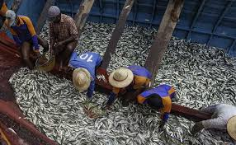
OTHER REVOLUTIONS
X10
White
(Milk)
  17 MT in 1950-51
  184 MT in 2018-19
Golden
(Horticulture)
  95.4 MT 1991-92
  314 MT 2018-19
X3
Blue
(Fish)
  0.75 MT 1950-51
  12.6 MT 2017-18
X14

Slide 6
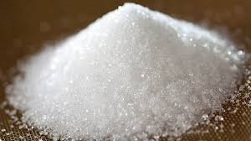
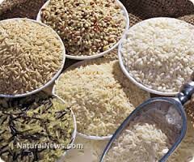
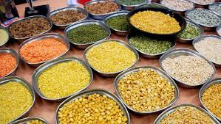
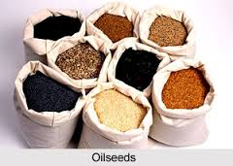
India’s Global Position
Commodity | India (m tons) | World (m tons) | % world share | Rank in the world
Rice | 118 | 741 | 14.8 | 2
Wheat | 107 | 716 | 13.7 | 2
Pulses | 23 | 73 | 31.5 | 1
Rapeseed | 8.7 | 72.7 | 10.9 | 3
Groundnut (in shell) | 9.3 | 46 | 16.5 | 2
Fruits (no melons) | 86 | 677 | 12.7 | 2
Vegetables & Melons | 167 | 1136 | 14.7 | 2
Sugarcane | 358 | 1911 | 16.0 | 2
Meat (000 MT) | 6215 | 310380 | 2.0 | 6
Milk (000 MT) | 184491 | 746708 | 20.8 | 1

Slide 7
WHY IT IS
NECESSARY TO REORIENT
INDIAN AGRICULTURE?
GREEN
WHITE
BLUE
Food
grains
Milk
Fish
DESPITE THESE REVOLUTIONS
CHALLENGES
SDG RELATED:
- Poverty
- Hunger
- Malnutrition
- Climate Change
FARMER RELATED:
- Low Income ?
- Youth Not
Interested
- Policy Support ?

Slide 8
Second Generation Problems of Green Revolution
Factor Productivity Decline
Decline in Soil Health and Water Table
Macro-nutrient Imbalance & Micro-nutrient Deficiency
Increased Incidence of Diseases and Pests
Dependence on Costly inputs & Reduced Farm Profitability
Higher Labor Cost – Shift Towards Farm Mechanization
In addition, overall Complacency has crept in

Slide 9
Economic Survey of India - 2018
Green Revolution
An over-exploitative and non-sustainable approach
Ensured food security at critical time
Mostly around Rice–Wheat system
Over-exploitation of water, soil nutrients, chemicals, energy etc.
Labor intensive
Dependence on Government subsidy/MSP
Source: GOI

Slide 10
Trends in Use of Key Inputs
(1970-2017)
Area (Million ha) | 1970-71 | 1980-81 | 1990-91 | 2000-01 | 2011-12 | 2016-17
Net sown | 140 | 140 | 143 | 141 | 141 | 140
Gross cropped | 165 | 172 | 186 | 185 | 196 | 198
Net irrigated | 31 | 39 | 48 | 55.2 | 66 | 68.3
Gross irrigated | 38 | 49.8 | 63.3 | 76 | 91.7 | 96.5
HYV | NA | 15.4 | 43 | 65 | 67
Fertilizer use | 2.2 | 5.5 | 12.5 | 16.7 | 27.8 | 25.9

Slide 11
Need for Reorientation for Profitable and Sustainable Agriculture
Diversification
Secondary Agriculture
Specialty Agriculture
Besides Production, now Post-production

Slide 12

No Poverty, Zero Hunger, Climate Action and Partnership

Slide 13
Youth and Agriculture
Global population is expected to be 9 billion by 2050; youth around 20 %
India has a comparative advantage over other countries with 356 million youth between 10-24 years age group; nearly 200 million living in rural areas
India’s population is expected to remain young longer than that of China and Indonesia
Average age of the Indian population is 30 years, as against 40 in USA, 46 in Europe and 47 in Japan
Agriculture is a key sector, sustaining around 55 % of India’s population
Youth and agriculture are the twin pillars for achieving SDGs

Slide 14
Challenges before Youth
Lack of access to good knowledge resulting in failure of new initiatives - needing institutional back up
Limited access to land - small land holdings
Lack of financial resources
Difficulties in linking to markets
No voice in decision-making
Poor social image of agriculture and lack of infrastructure facilities in rural areas
There exists ‘aspiration-attainment gap’ due to lack of hand holding, mentorship and funding support

Slide 15
Way Forward
Think Globally
Act Locally
Notes:
15

Slide 16
Global/Regional Initiatives
Challenge to retain youth in agriculture first figured prominently during the Global Conference organized by GFAR in New Delhi - 2006.
An international forum of Young Professionals for
Agricultural Development (YPARD) was launched under the umbrella of GFAR at FAO, Rome
. The importance of youth in agriculture was further emphasized and structurally debated during GCARD 1 and 2, organised in 2010 and 2012, respectively
Regional Workshop on ‘Youth and Agriculture: Challenges and Opportunities’ organised in Islamabad - 2013

Slide 17



Slide 18
National Initiatives
ICAR, APAARI and TAAS organized a national workshop on ‘Foresight and Future Pathways of Agricultural Research through Involvement of Youth in India’ at New Delhi - 2013 – Led to ARYA program by ICAR
Regional Conference on Motivating and Attracting Youth in Agriculture (MAYA) organised in New Delhi - 2018.
Zonal Workshop on Youth as Torch Bearers of Business Oriented Agriculture in South India organised by TAAS and PJTSAU, Hyderabad - 2019.
Zonal Workshop on Promoting and Attracting Youth in Agriculture in North India organised by TAAS and PAU at Ludhiana- 2020

Slide 19
Govt. Initiatives on Youth
A program on Attracting and Retaining Youth in Agriculture (ARYA) functioning under ICAR since 2013
Student READY (Rural Entrepreneurship Awareness Development Yojana) program initiated by ICAR in 2015-16 by reorienting rural agricultural work experience (RAWE) program
Start-up India - Ministry of Commerce and Industry initiative - since January 2016
Stand-up India - initiative by the Department of Financial Services (DFS) to encourage youth from scheduled caste and scheduled tribes to become entrepreneurs
National Skill Development Mission - launched for creating convergence across various sectors and different states with respect to activities relating to skills training

Slide 20
Govt. Initiatives on Youth
Make in India - Ministry of Commerce and Industry, launched in September 2014
Skill India Mission – launched in September 2014; Ministry of Skill Development and Entrepreneurship
Pradhan Mantri Kaushal Vikas Yojana (PMKVY)- by the Ministry of Skill Development and Entrepreneurship to provide the country’s youth training for meaningful industry-relevant skills
PM-YUVA- (Yuva Udyamita Vikas Abhiyan) - It is a centrally-sponsored scheme related to entrepreneurship, education and training for youth (both men and women).

Slide 21
Future Road Map
Need for paradigm shift from narrow focus on ‘youth as a farmer’ to ‘youth as a value chain developer’ to harness better economic opportunities
Govt. to provide enabling policy environment for long-term investments, easy and soft credit availability, provision of subsidy to entrepreneurs, easy market linkage, land, water and market law reforms, and tax exemption for rural-based primary value addition by youth
The private sector to help create an ‘Agri-Youth Innovation Corpus Fund’ and facilitation for creation of Agri-Clinics under corporate social responsibility (CSR)

Slide 22
Future Road Map
Create a separate ‘Department of Youth in Agriculture’ to ensure collaboration and coordination with concerned departments in other Ministries
Establish a ‘National Mission on Youth in Agriculture’ to promote: i) sustainable, secondary and specialty agriculture, ii) efficient knowledge dissemination, iii) technical backstopping, iv) developing new agribusiness models, and v) entrepreneurship and value chain development
Encourage youth to set-up agri-service centres to offer custom-hire services for farm mechanisation
Encourage youth to get involved in e-NAM, start-up, stand-up and skill development schemes, agri-business enterprises, FPOs etc

Slide 23
Motivating & Attracting Youth in Agriculture (MAYA)
To be Job Creator and not Job Seeker:
  - Youth (including women) as extension agents – Paid extension
  - Youth as input providers
  Youth as Entrepreneurs
  Promoting the model of Agri-Clinic
  in each District (involving KVK, ATMA and Private Sector)

Slide 24
Scaling
Innovation
Critical for Future
Success

Slide 25
Scaling Innovations
Hybrid Technology (maize, bajra, sorghum, rice)
Biotechnology - GM crops (soybean, mustard, maize, brinjal)
Conservation Agriculture (>20 mha)
Protected Cultivation (expand area to 0.5 m ha)
Micro-irrigation (discourage use of flood irrigation)
Bioenergy/Biofuel (use of sugar cane and maize up to 20%)
Biofortified Crops (Quality protein maize, iron & zinc rich rice, iron rich bajra, zinc rich wheat)
ICT for Knowledge Empowerment

Slide 26
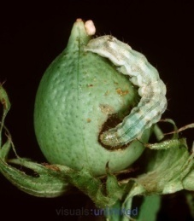
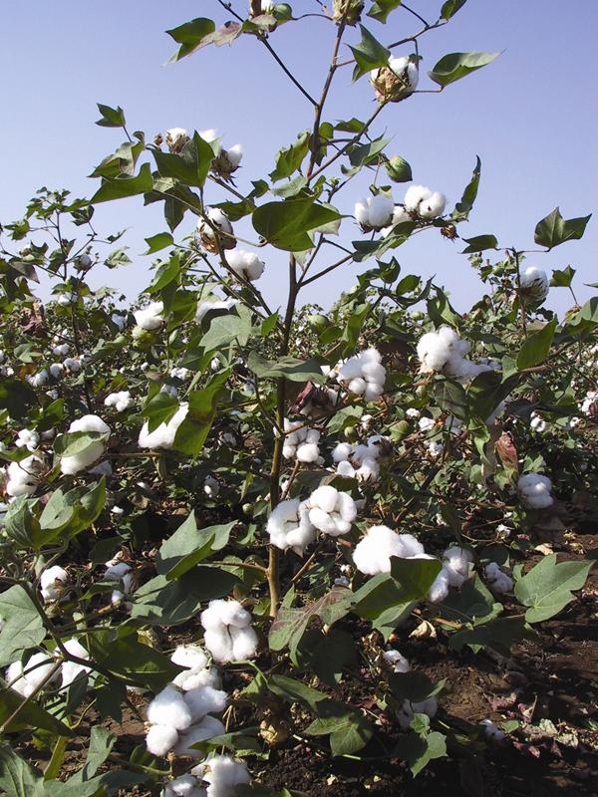
Bt Cotton - A Success Story
In India, the area under Bt cotton has reached between
11-12.0 mha now, nearly 95% of total area.
The cotton production has almost
tripled (36.05 million bales)
Pesticide consumption has
reduced by 40 %
Income of 5 million cotton
farmers increased - between
US $100 - 300/ha
Export of cotton now around:
US $3.5 to 4.5 billion
last year
Notes:
26
26

Slide 27
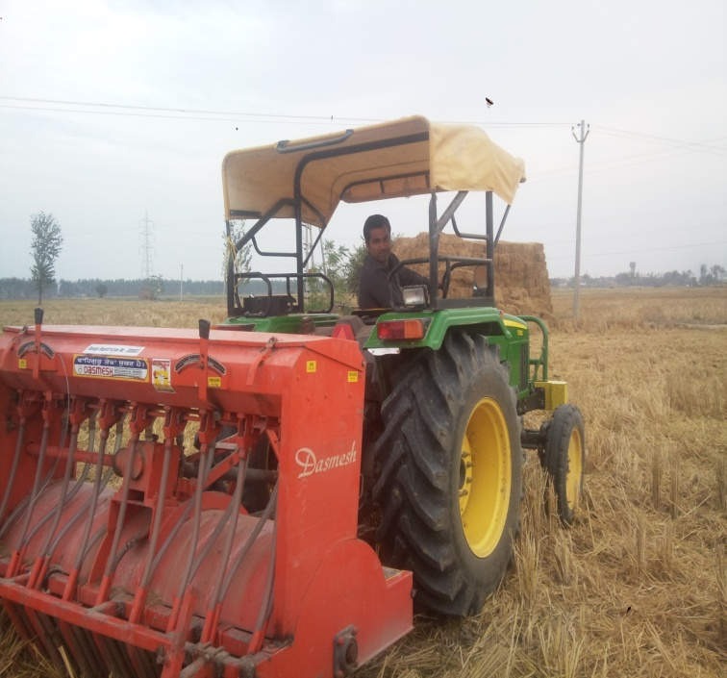
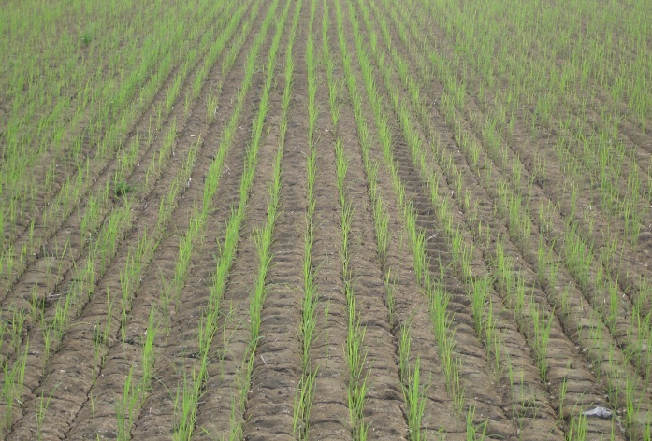
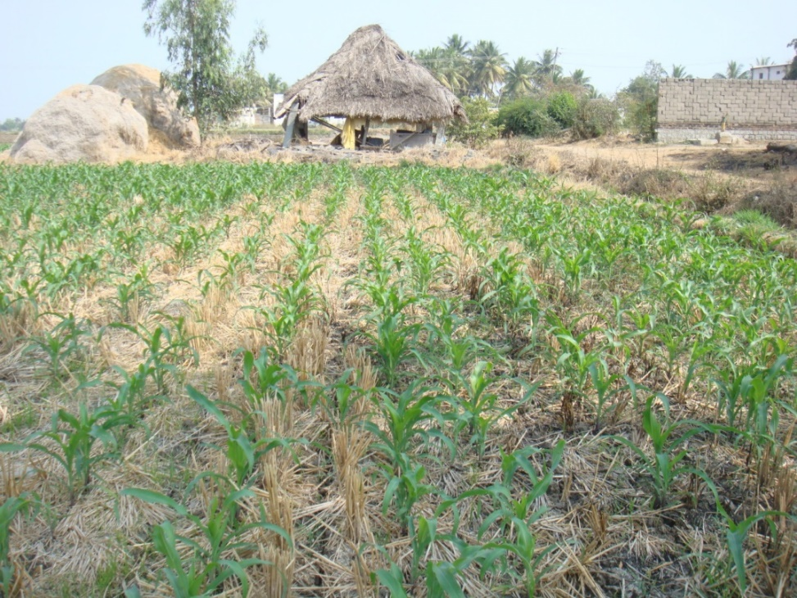
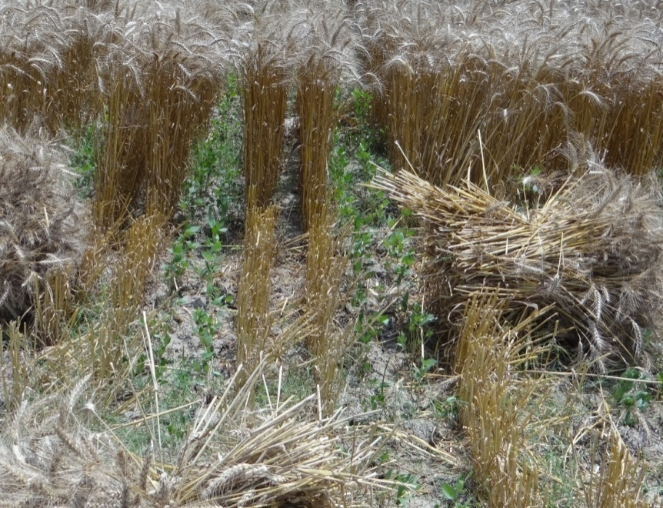
Conservation Agriculture
Area covered : 5.0 m ha
Potential area : 10 m ha (R-W alone)

Slide 28
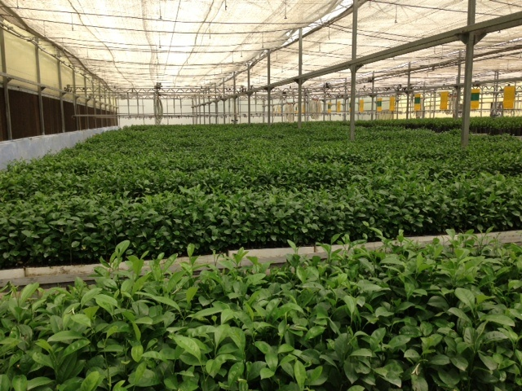
Protected Cultivation Area
India - (50,000 ha) China - (2.0 m ha)

Slide 29
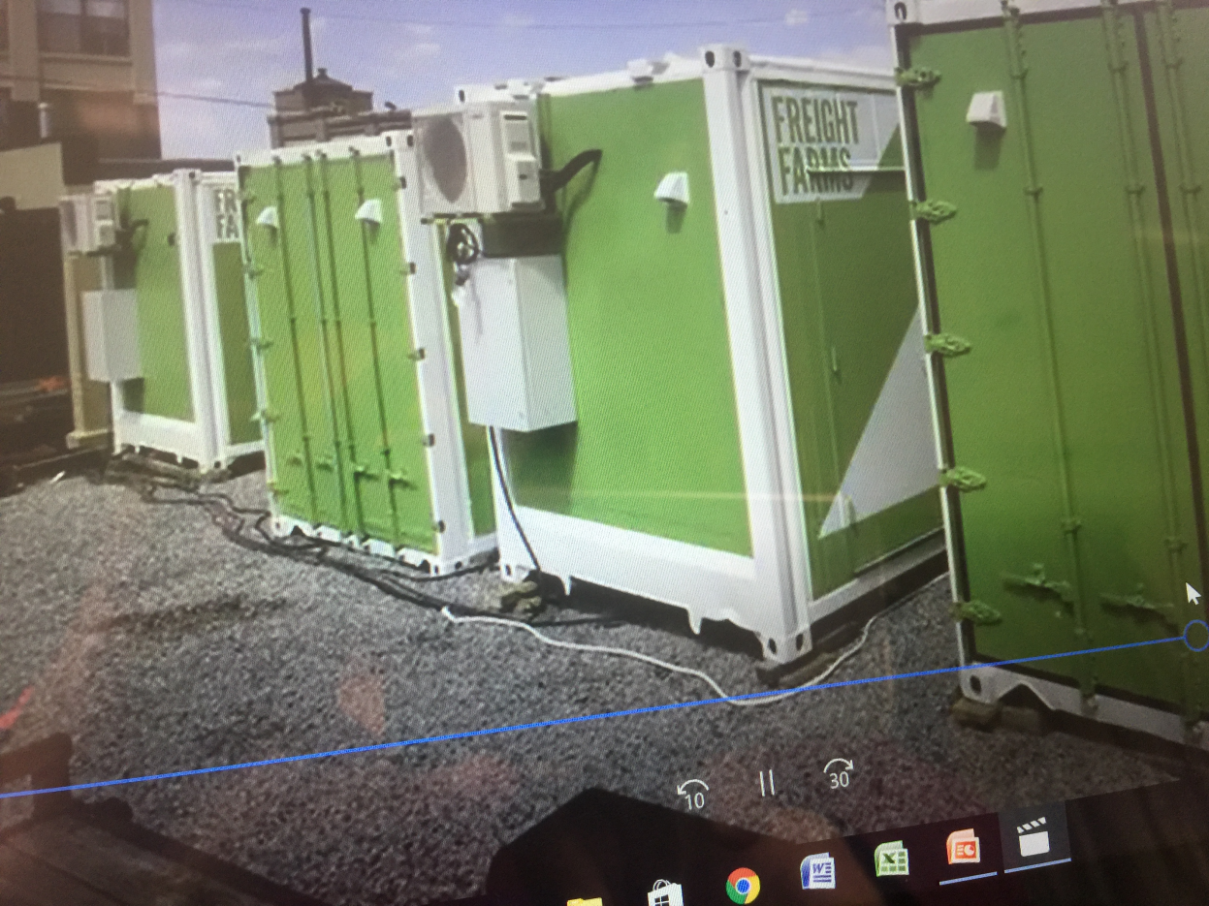
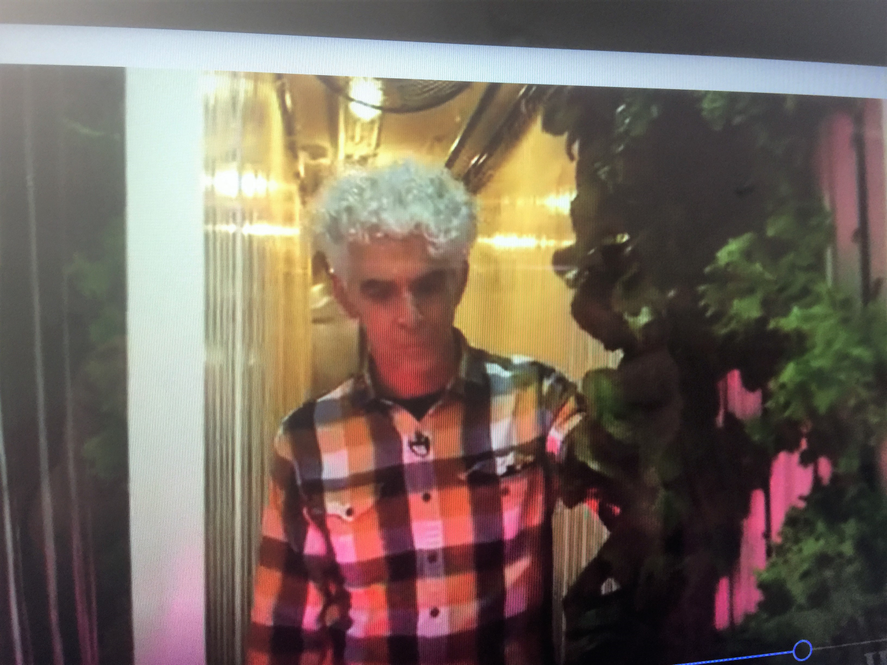
Are Shipping Containers the Future of Farming?
One repurposed Shipping Container can grow 2 Acre’s worth of produce

Slide 30
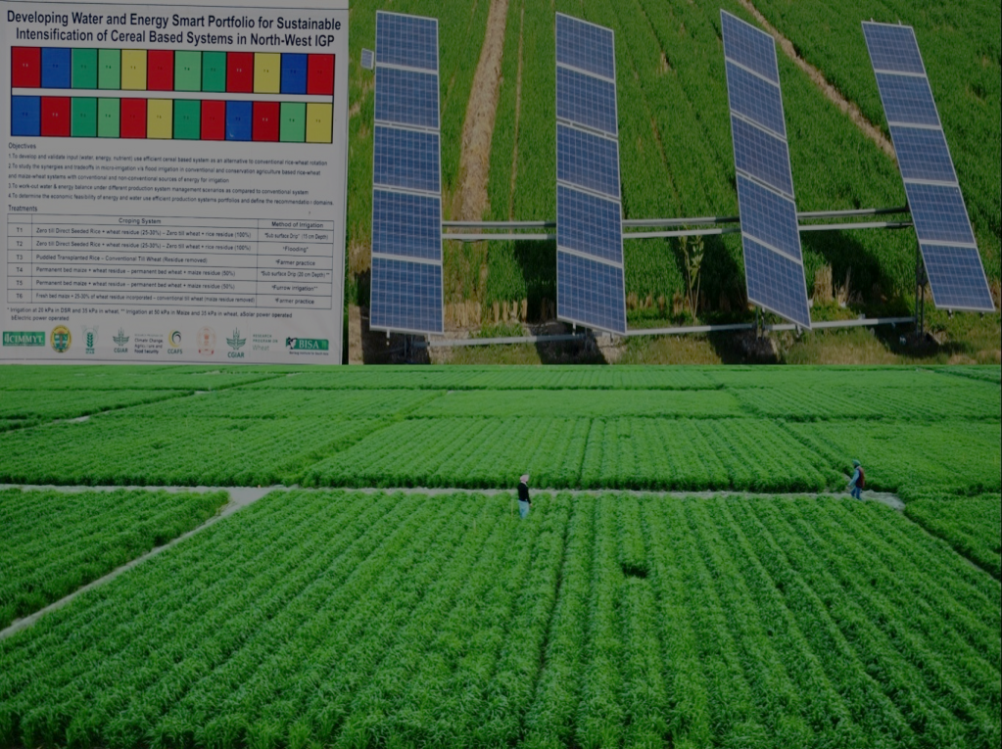
Micro-irrigation
(Around 10.0 out of 66.0 m ha irrigated area)
Sub Surface drip (SSD) irrigation system in CA based rice-wheat system resulted in :
  0.75 t/ha/year higher yield
  With ~70 cm less water use
  With 20% less fertilizer (higher NUE)
  CA in rice-wheat
  system saves cost,
  energy and labor
  Lower foot prints
Source: Sidhu and Jat, CIMMYT-BISA (2016)

Slide 31
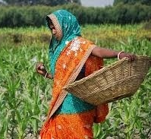
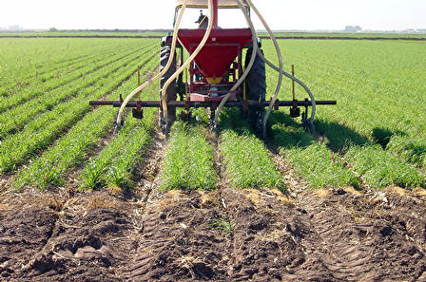
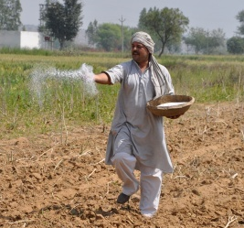
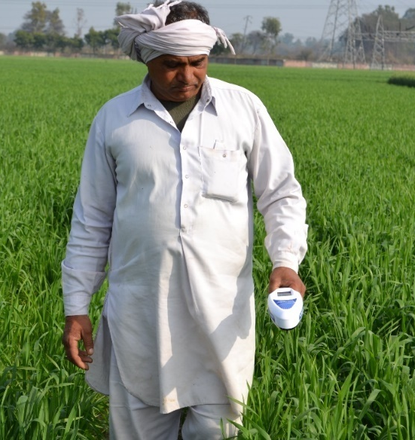
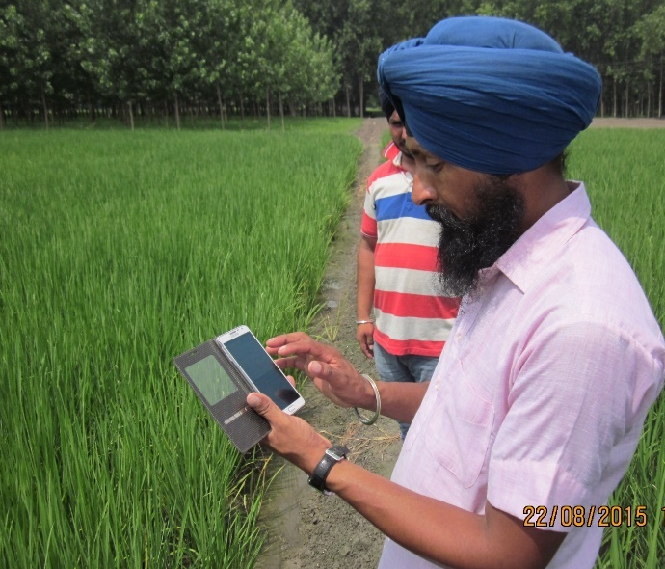
Shift Towards Precision Farming
Use of Decision Support Systems

Slide 32
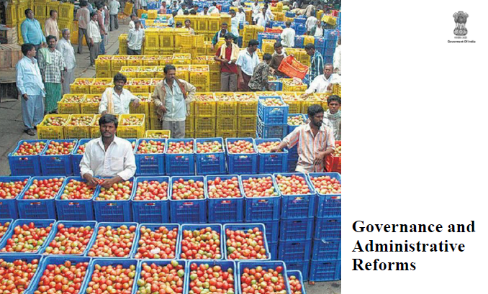

Slide 33
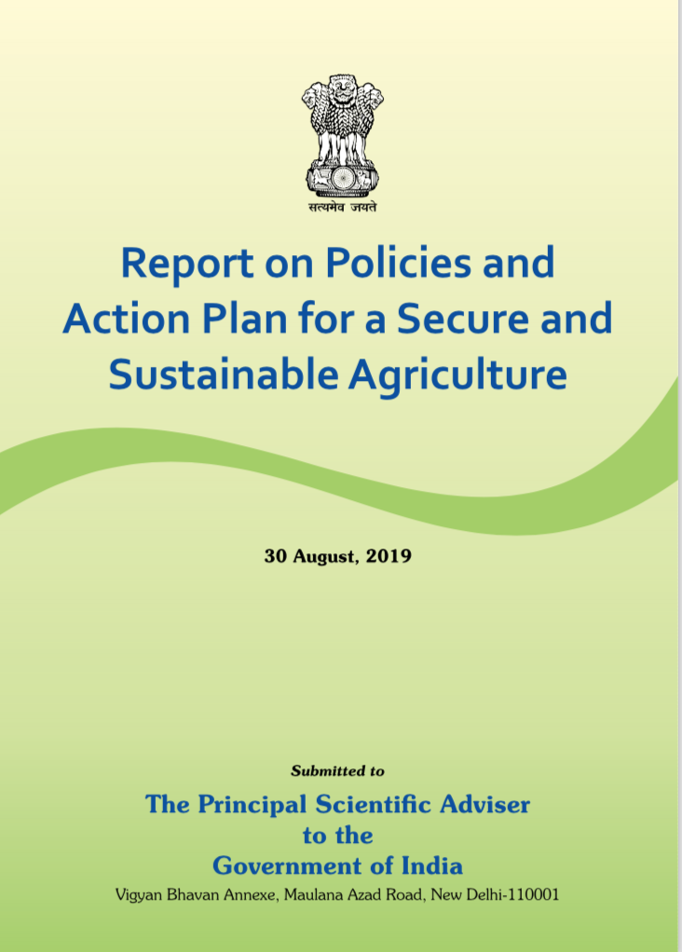
Committee on Agriculture
>150 Specialists & Stakeholders
Consultants (TAAS)
12 Expert Members
Chairman &
Member
Secretary

Slide 34
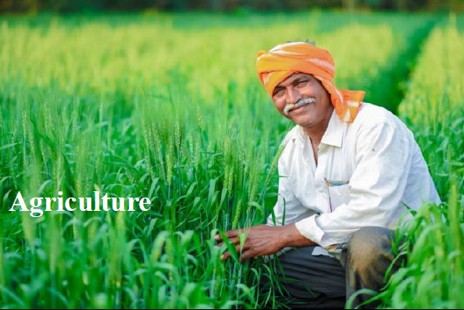
Farmer First

Slide 35
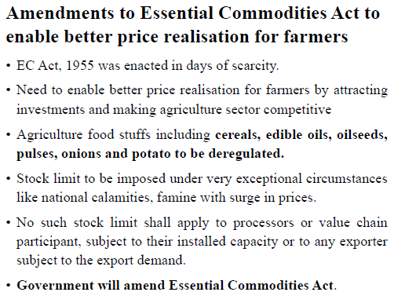

Slide 36
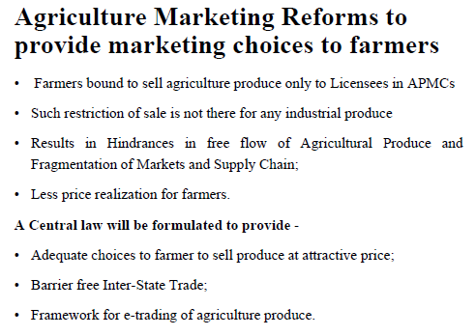

Slide 37
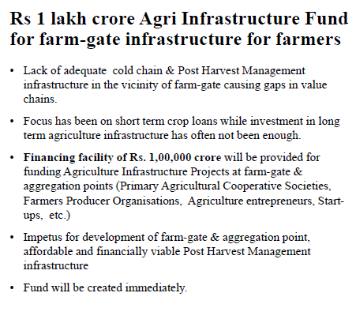

Slide 38
Conclusion
Our future challenge is for food, nutrition, health and environmental security
Agriculture is not the cause but solution for achieving SDGs and to bridge the widening gap between rich and poor – Yet, the business as usual will not do
The task ahead is indeed difficult, but not insurmountable provided needed policy support is given and AR4D funding is doubled
Scaling innovations would require right incentives, policies, institutions, human resource (mainly youth) and public private partnership
So, we must have a clear Way Forward and act fast to achieve secure and sustainable agriculture

Slide 39

Towards a Better Future

